Slide 1

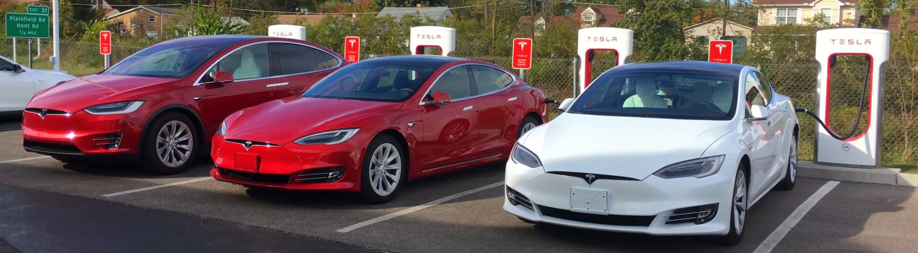
DA 353 - Dr.Bonifonte
introduction
data exploration
model formulation
result
sensitivity analysis
conclusion
Optimized Strategy for Electric Vehicle Charging Station Allocation
Team: Minh Le & Yen Nguyen

Slide 2
DA 353 - Dr.Bonifonte
introduction
data exploration
model formulation
result
sensitivity analysis
conclusion
table of contents
introduction
result
background information
solve the model using Gurobi
data exploration
sensitivity analysis
explore dataset
explore key factors that shape our model
model formulation
conclusion
formulate model
limitations & future studies

Slide 3
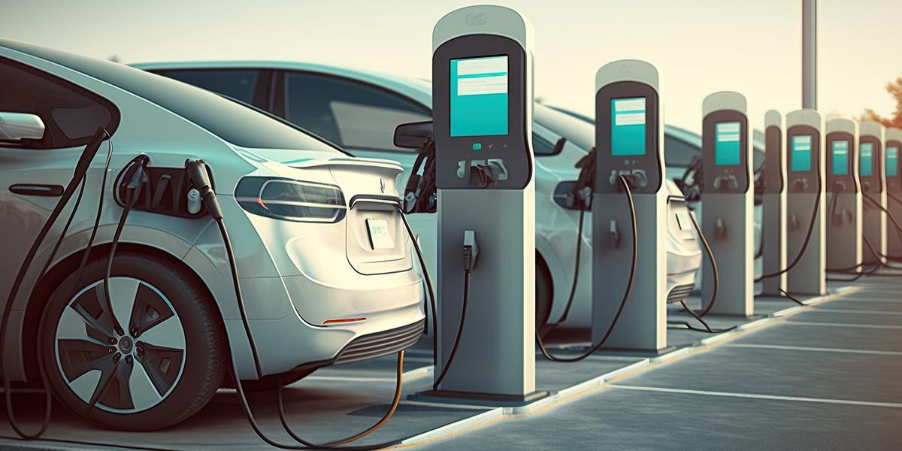
DA 353 - Dr.Bonifonte
introduction
data exploration
model formulation
result
sensitivity analysis
conclusion
introduction.

Slide 4
DA 353 - Dr.Bonifonte
introduction
data exploration
model formulation
result
sensitivity analysis
conclusion
“
In order to have a clean air in cities, you have to go electric.
— Elon Musk (Founder of Tesla)

Slide 5
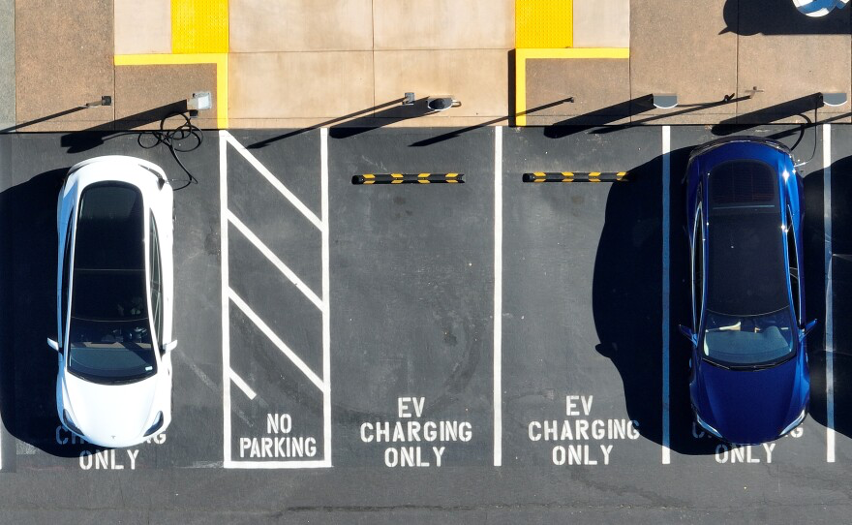
DA 353 - Dr.Bonifonte
introduction
data exploration
model formulation
result
sensitivity analysis
conclusion
situation
Transportation is the largest source of greenhouse gas emissions in King County, accounting for nearly 50% of all GHG emissions that occur within King County’s geography.
50% of light-duty vehicles are transitioned to electric by 2025 and 100% by 2030.
50% of medium-duty vehicles are transitioned to electric by 2028 and 100% by 2033.
50% of heavy-duty vehicles are transitioned to electric vehicles by 2038 and 100% by 2043.
→ Installation of 150 chargers by 2030 in county facilities.
According to King County Environmental Sustainability Program - Title 18
Notes:
Currently, a large amount of emissions coming from transportation. In King County, 50% of all GHG emissions coming from this.

Slide 6

DA 353 - Dr.Bonifonte
introduction
data exploration
model formulation
result
sensitivity analysis
conclusion
Zero Emissions by 2035
A project lead by Metro, the only large transit agencies in the country working toward a 100% zero-emissions fleet, in King County, Seattle, aims for a fully zero-emissions fleet by 2035. This includes procuring zero-emissions buses, investing in electric trolleys, and enhancing charging infrastructure to cut air and noise pollution.

Slide 7
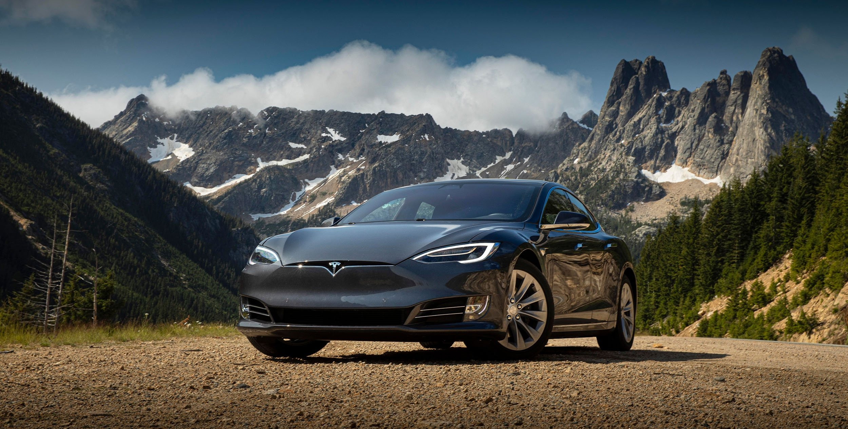

DA 353 - Dr.Bonifonte
introduction
data exploration
model formulation
result
sensitivity analysis
conclusion
motivation
vision
Increasing EV adoption highlights the importance of strategic charging station placement to optimize infrastructure efficiency and minimize redundancy. Despite progress in public transit initiatives like Metro's Zero Emissions project, there remains a critical gap in infrastructure for private EV vehicles.
Our project aims to optimize the allocation of electric vehicle charging stations in King County, Seattle, using data from the official Washington state open data portal on registered electric vehicles. Our goal is to strategically design stations to maximize coverage across locations and meet demand efficiently.
Notes:
Although there are development in EV infrastructure,…

Slide 8
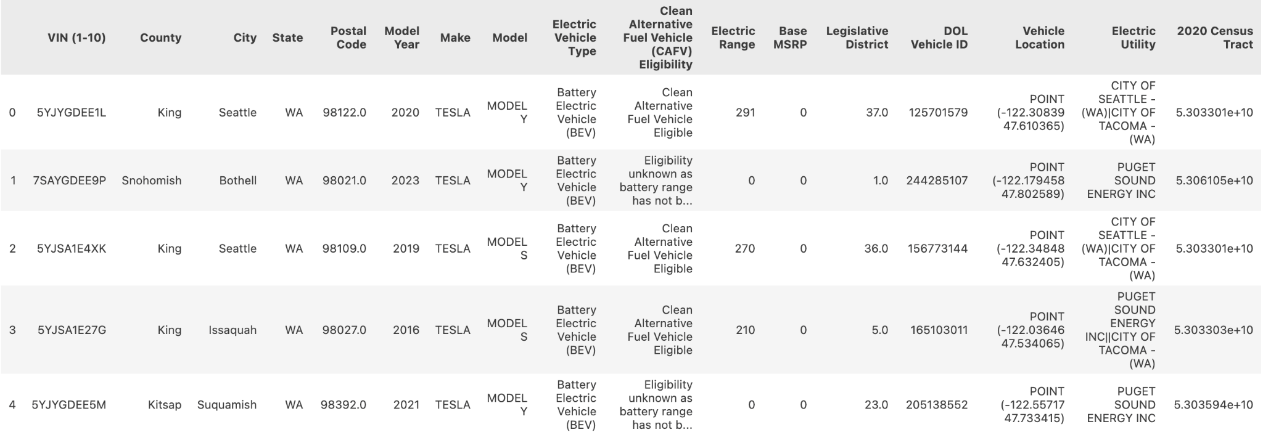
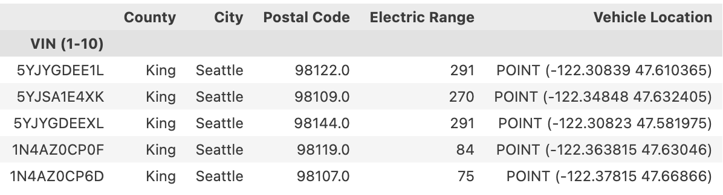
DA 353 - Dr.Bonifonte
introduction
data exploration
model formulation
result
sensitivity analysis
conclusion
dataset
Electric Vehicle Population Data
Source: Washington State Department of Licensing (DOL) via data.gov
This dataset provides valuable insights into vehicle distribution and usage patterns, crucial for optimizing charging station locations.
The data contains 17 columns and 177,867 rows.
Notes:
The dataset presents registered Battery Electric Vehicles (BEVs) and Plug-in Hybrid Electric Vehicles (PHEVs) through the Washington State Department of Licensing (DOL). It has unique IDs for the vehicles, location details (city, state (WA for all), postal codes, longitude, and latitude), vehicle specifics (model year, manufacturer, models), electric utility, and more. However, due to the extensive data, our attention is directed toward electric vehicles specifically in King County, Seattle with only several variables. Given the county’s dense population and central location within the state, this focus provides valuable insight.

Slide 9
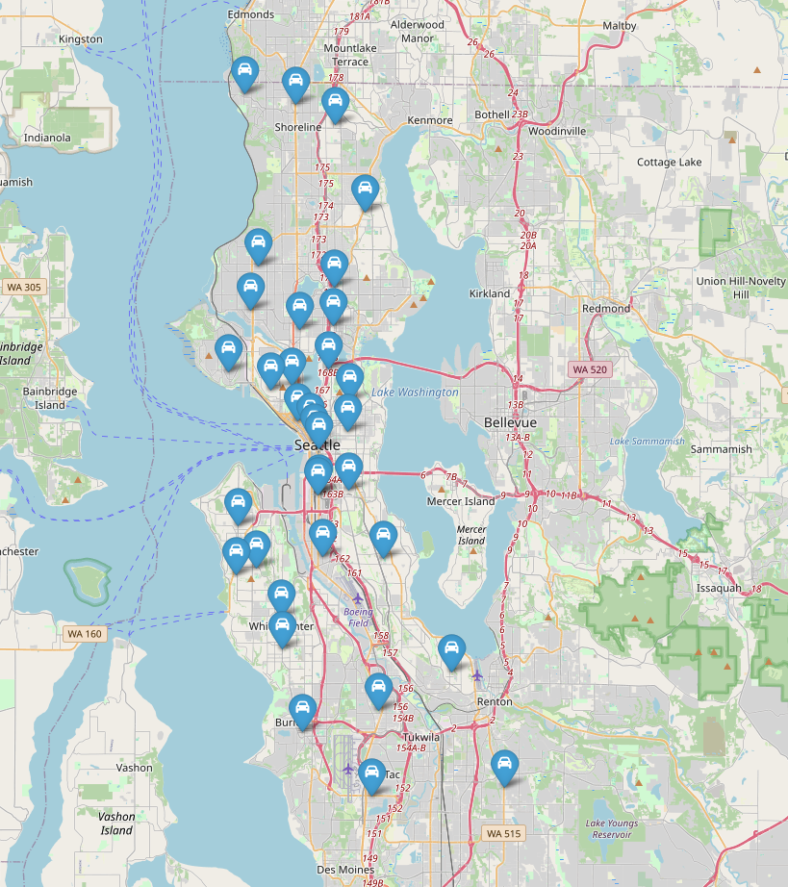
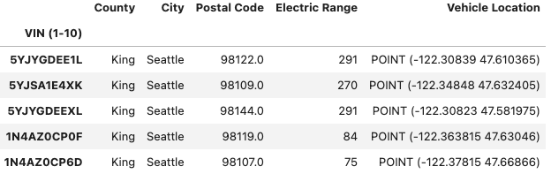
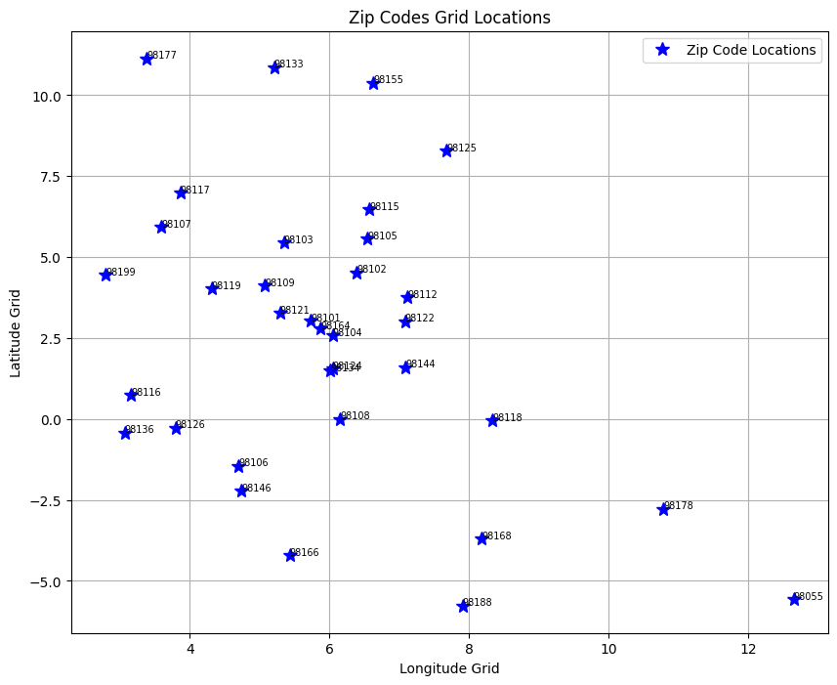
DA 353 - Dr.Bonifonte
introduction
data exploration
model formulation
result
sensitivity analysis
conclusion
what we do?
We use Postal Code to identify where the EVs are registered in Seattle.
Then we convert the location using latitude and longitude into grid location for further development and analysis.
data exploration.

Slide 10
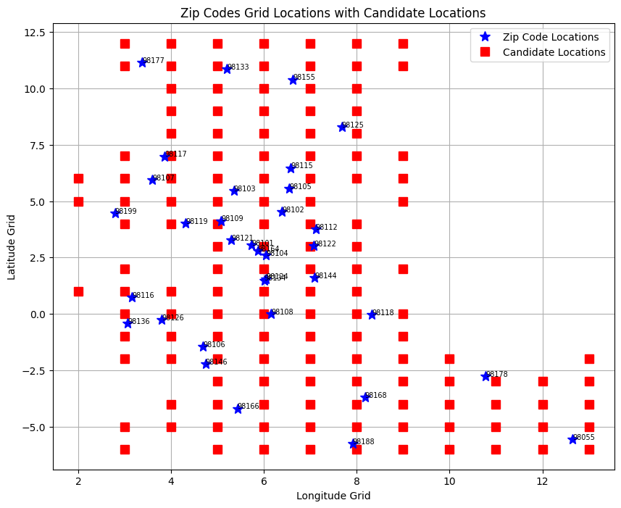
DA 353 - Dr.Bonifonte
introduction
data exploration
model formulation
result
sensitivity analysis
conclusion
what we do?
Based on the grid location, we established the range within which candidate locations should be selected: longitude [3, 13] and latitude [-6, 12].
We prioritized integer points on the grid as potential candidate locations.
To reduce our computability time, we removed points that are either located in the sea when converted back to the map or located in the area that are outside the maximum distance threshold.

Slide 11
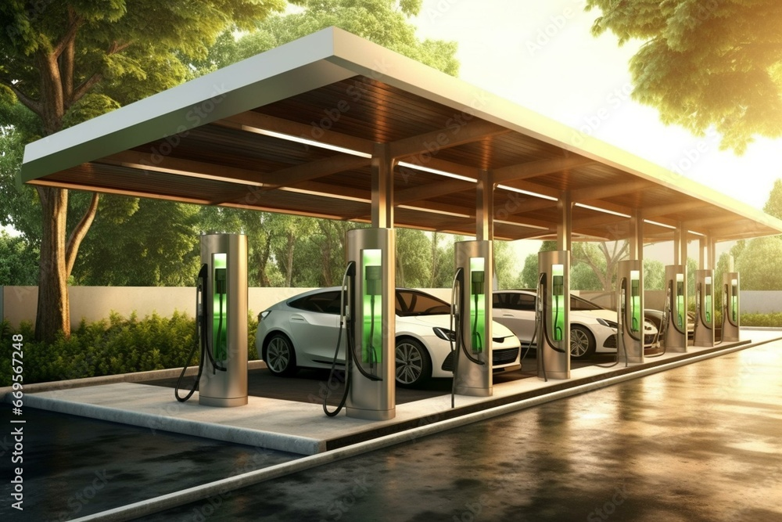
DA 353 - Dr.Bonifonte
introduction
data exploration
model formulation
result
sensitivity analysis
conclusion
model formulation.

Slide 12

DA 353 - Dr.Bonifonte
introduction
data exploration
model formulation
result
sensitivity analysis
conclusion
key assumptions
Uniform power consumption demand for each vehicle, based on average electric car consumption.
Consistent construction cost and power capacity for new stations across all locations.
Vehicle location specified by Postal Code.
We consider the candidate locations as potential sites for station installations.

Slide 13
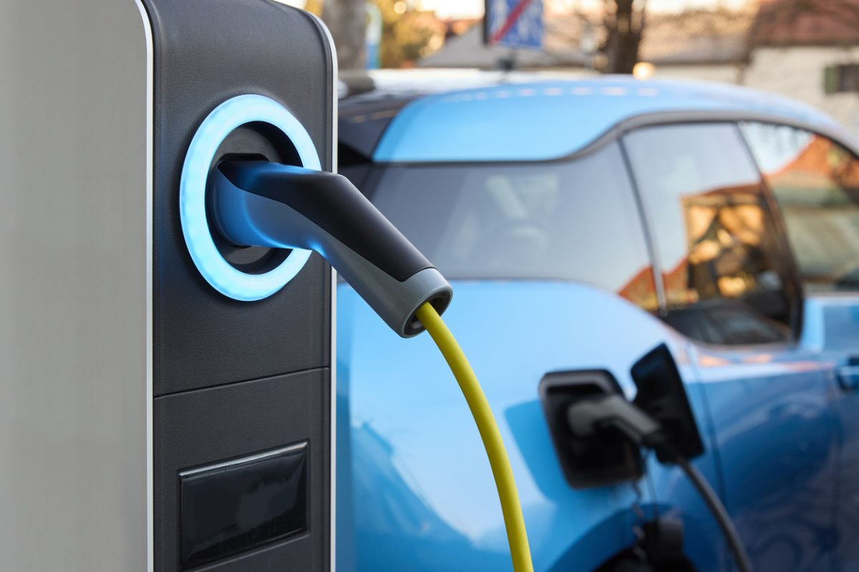

DA 353 - Dr.Bonifonte
introduction
data exploration
model formulation
result
sensitivity analysis
conclusion
data
Z: the set of postal codes obtained from the dataset.
S: the set of candidate charging locations.
D: the distance threshold between the vehicles and their assigned stations
ST: the maximum number of candidate locations can be opened.
S_{j}: the maximum supply of the candidate location j.
d_{ij}: the distance between vehicle in postal code i and station j.
n_{i}: the number of cars require charging in postal code i.
decision variables
C_{j}: Binary variable indicating whether to open the candidate station j.
X_{ij}: Continuous variable representing the proportion of vehicles in postal code i chooses location j for charging service.
objective function
Maximize the station coverage of the stations opened:
model

Slide 14
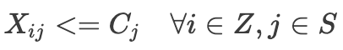
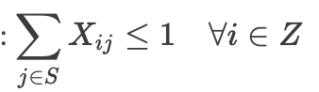
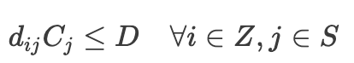
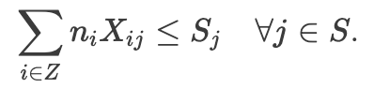
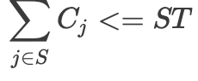
DA 353 - Dr.Bonifonte
introduction
data exploration
model formulation
result
sensitivity analysis
conclusion
constraints
Only charge at the stations that have been selected:
Vehicle charging constraint:
Limit the distance between each postal code and its assigned candidate location to a maximum threshold of D units: D = 2.0
Ensure that the total demand supplied by each candidate location does not exceed its maximum supply: S = 300
Ensure that only ST candidate locations are chosen: ST =100
model
Notes:
D = 2 : The 2 units distance threshold we choose is equal to about 5 miles in real mapping. Since these are Euclidean distances, real distances considering road path will be somewhat larger, so we estimate the real-life distance to be around 10-12 miles.
ST = 100
S = 300

Slide 15
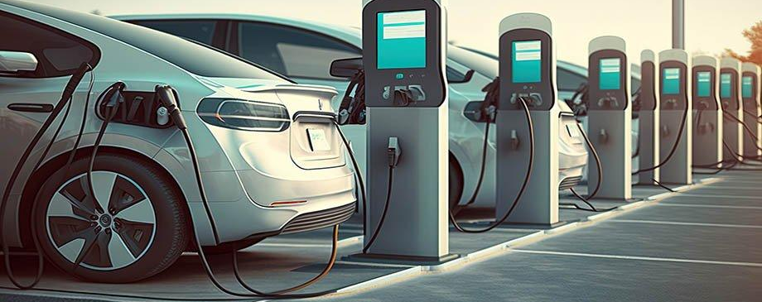
DA 353 - Dr.Bonifonte
introduction
data exploration
model formulation
result
sensitivity analysis
conclusion
results.

Slide 16
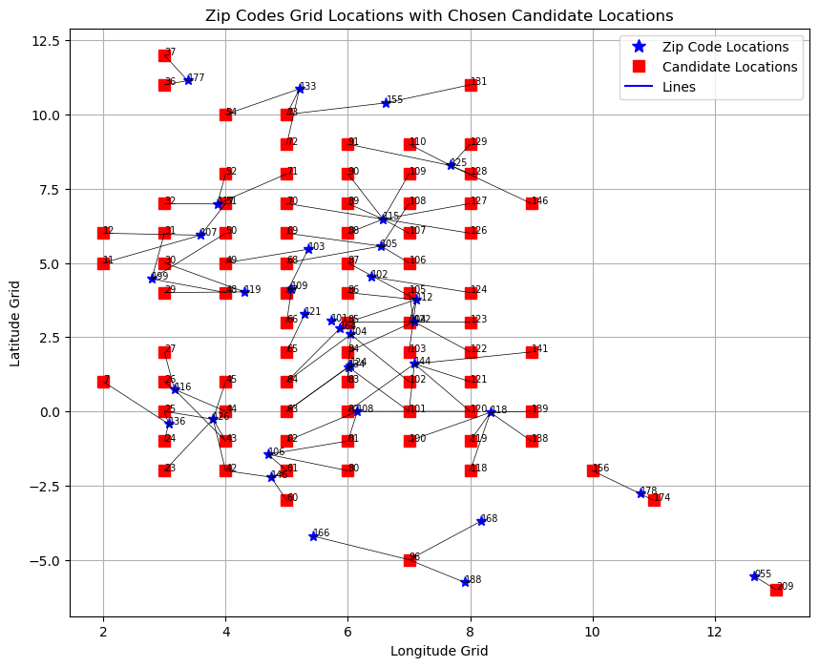
DA 353 - Dr.Bonifonte
introduction
data exploration
model formulation
result
sensitivity analysis
conclusion
81 locations are chosen
Number of vehicles can be covered: 22,749 vehicles
Coverage: 77.25% of the total demand
Figure1: zip codes’ names and candidate stations’ indices

Slide 17
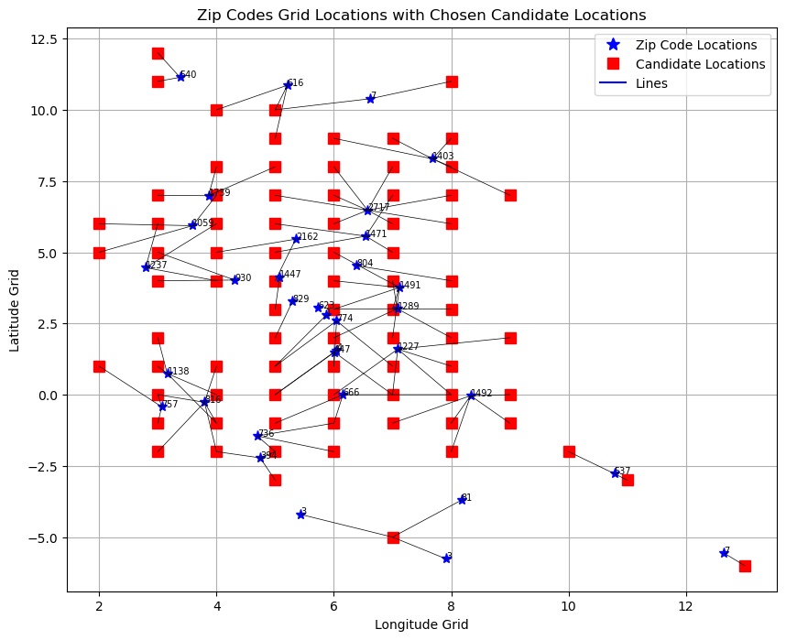
DA 353 - Dr.Bonifonte
introduction
data exploration
model formulation
result
sensitivity analysis
conclusion
The candidate locations are mainly placed in densely populated central areas to cover as many postal code as possible. Placing stations here allows them to serve multiple ZIP codes effectively.
However, because each location has a limit on how many cars it can charge (300), they tend to cluster around these central areas. This clustering ensures that each station can meet the demand within its capacity while still covering a wide area. So, the strategy is to balance demand, supply limits, and coverage goals to create an efficient charging network.
Figure 2: zip codes and their corresponding demand

Slide 18
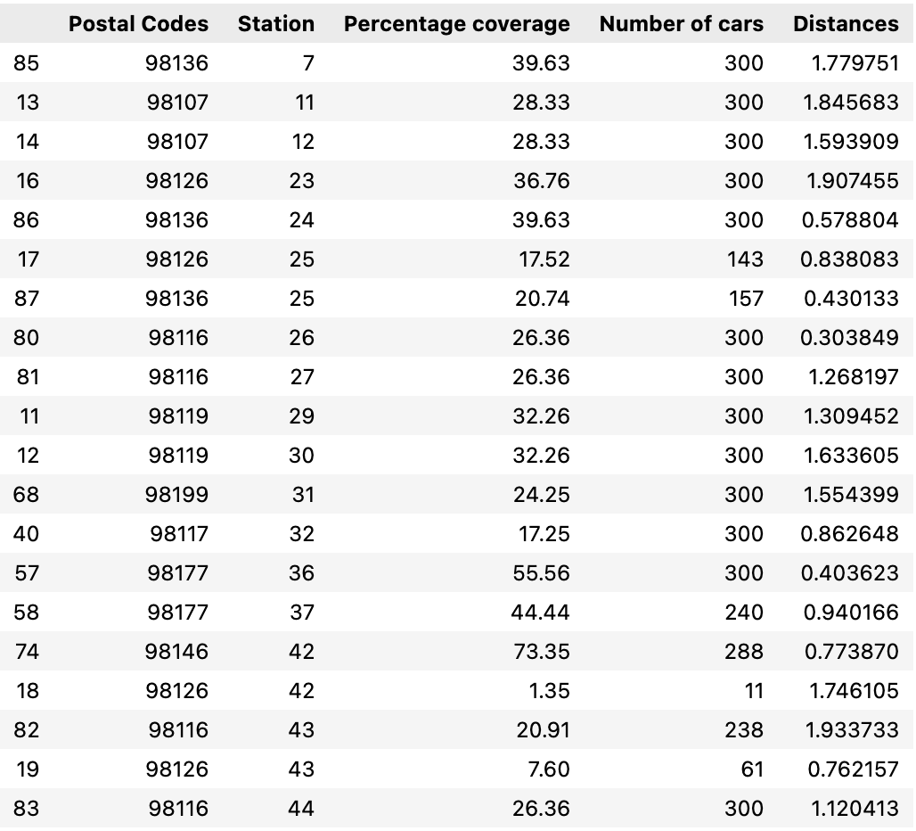
DA 353 - Dr.Bonifonte
introduction
data exploration
model formulation
result
sensitivity analysis
conclusion
Proportions of Vehicles Covered by each Station in each Postal Code
summary table: 20 first rows

Slide 19
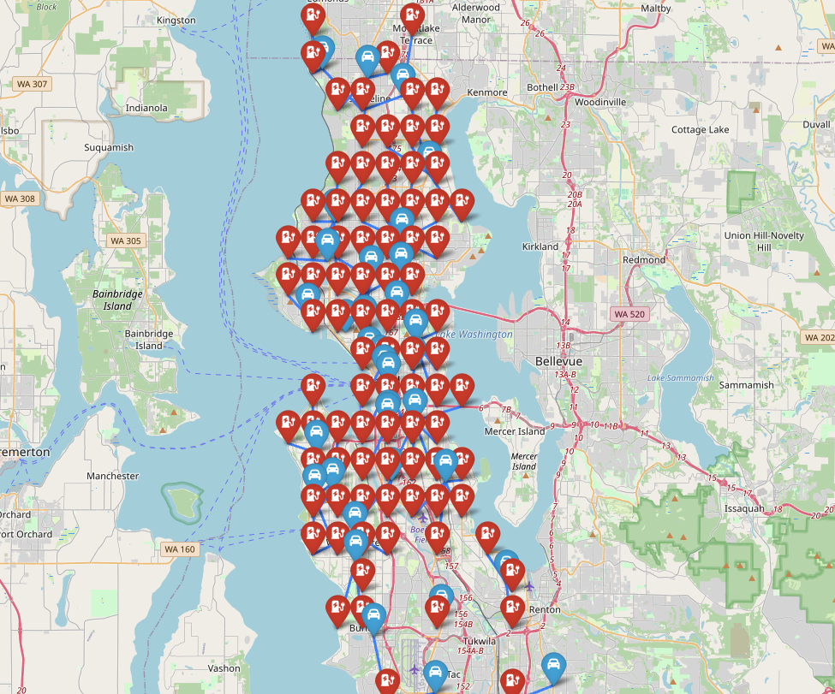
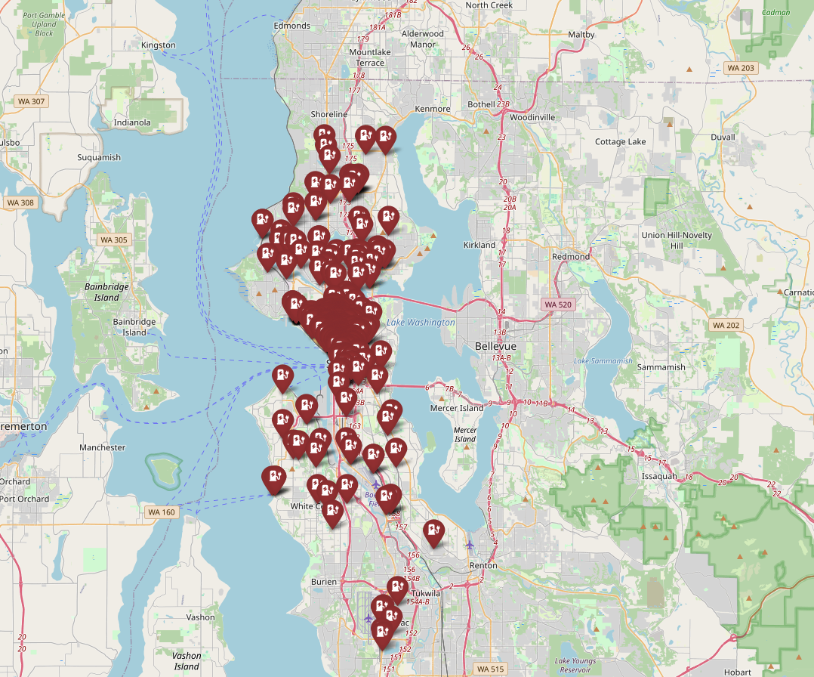
DA 353 - Dr.Bonifonte
introduction
data exploration
model formulation
result
sensitivity analysis
conclusion
our results
current location
After comparing our result with the current map of charging stations in Seattle, we found a remarkable similarity between the two maps.
However, our result suggests that more charging station should be opened and expanded in the following locations: Shoreline, Mountlake Terrace, Magnolia, Burien, White Center, and Fairwood. In addition, regarding the central parts of Seattle, the number of charging locations should be reduced.

Slide 20
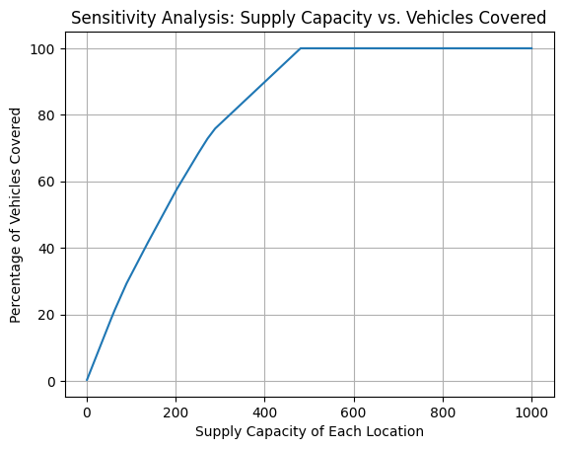
DA 353 - Dr.Bonifonte
introduction
data exploration
model formulation
result
sensitivity analysis
conclusion
sensitivity analysis.
Increasing the supply capacity of each station leads to a higher percentage of cars covered.
The coverage percentage rises notably until it reaches 300 cars per station.
Beyond 300 cars per station, the coverage still increases but at a slower rate.
It stabilizes at 100% coverage when the supply reaches around 500 cars per station.

Slide 21
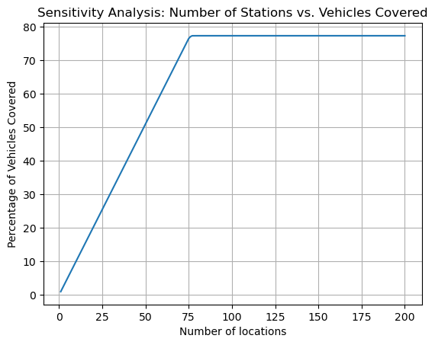
DA 353 - Dr.Bonifonte
introduction
data exploration
model formulation
result
sensitivity analysis
conclusion
sensitivity analysis.
Increasing the number of stations initially leads to a linear rise in vehicle coverage.
However, after exceeding 81 locations, the coverage growth begins to stabilize at around 78% of the demand.
This indicates that adding more stations doesn't improve coverage much, likely due to location constraints and limited options for placing stations.

Slide 22
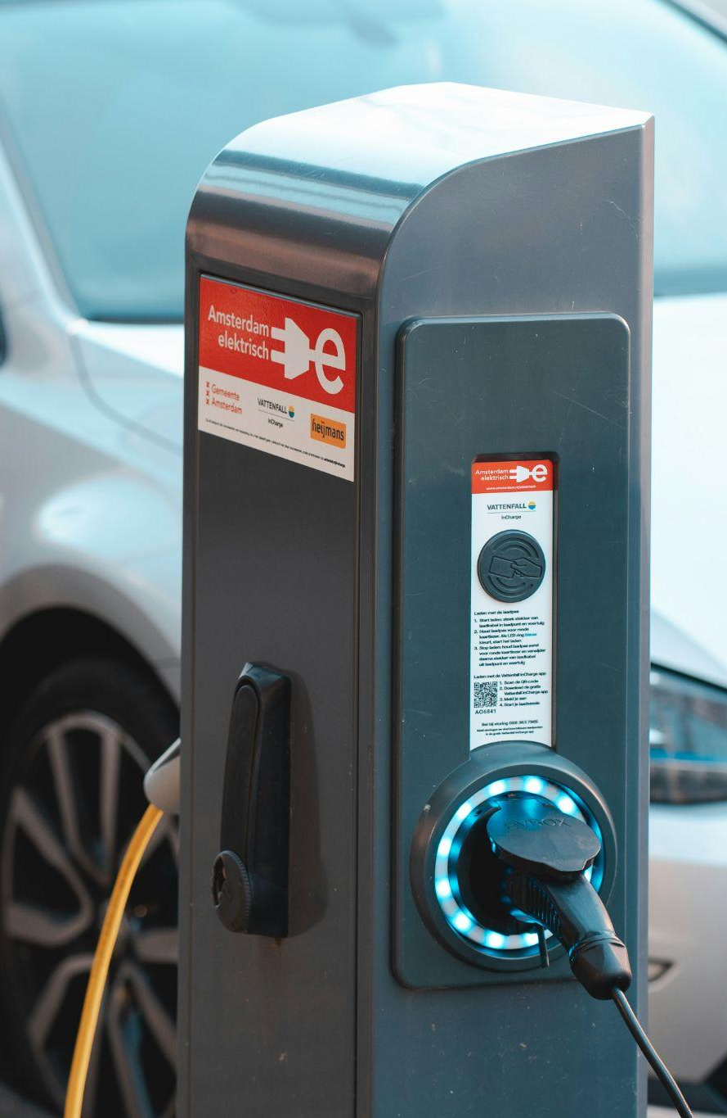
DA 353 - Dr.Bonifonte
introduction
data exploration
model formulation
result
sensitivity analysis
conclusion
conclusion.
limitations
use of ZIP codes for EV user location representation limits optimization of station selection.
overlooks factors like land ownership, existing infrastructure, and consumer behaviors.
potential constraints include prohibited construction areas or inadequate electricity supply.
model assumes fixed maximum supply per station and regulations on station construction, which may not reflect real-world variability.
factors like construction and environmental costs are not accounted for in location selection.
future studies
incorporate different data sources, such as land ownership, charginging station construction costs, and real-time traffic data to get a more comprehensive understanding of charging demand and selections within different geographic areas
explore alternative objectives (minimize total cost, including construction and environmental costs)

Slide 23
DA 353 - Dr.Bonifonte
introduction
data exploration
model formulation
result
sensitivity analysis
conclusion
conclusion.
limitations
use of ZIP codes for EV user location representation limits optimization of station selection.
overlooks factors like land ownership, existing infrastructure, and consumer behaviors.
potential constraints include prohibited construction areas or inadequate electricity supply.
model assumes fixed maximum supply per station and regulations on station construction, which may not reflect real-world variability.
factors like construction and environmental costs are not accounted for in location selection.
future studies
incorporate different data sources, such as land ownership, charginging station construction costs, and real-time traffic data to get a more comprehensive understanding of charging demand and selections within different geographic areas
explore alternative objectives (minimize total cost, including construction and environmental costs)

Slide 24
DA 353 - Dr.Bonifonte
introduction
data exploration
model formulation
result
sensitivity analysis
conclusion
conclusion.
limitations
use of ZIP codes for EV user location representation limits optimization of station selection.
overlooks factors like land ownership, existing infrastructure, and consumer behaviors.
potential constraints include prohibited construction areas or inadequate electricity supply.
model assumes fixed maximum supply per station and regulations on station construction, which may not reflect real-world variability.
factors like construction and environmental costs are not accounted for in location selection.
future studies
incorporate different data sources, such as land ownership, charginging station construction costs, and real-time traffic data to get a more comprehensive understanding of charging demand and selections within different geographic areas
explore alternative objectives (minimize total cost, including construction and environmental costs)

Slide 25
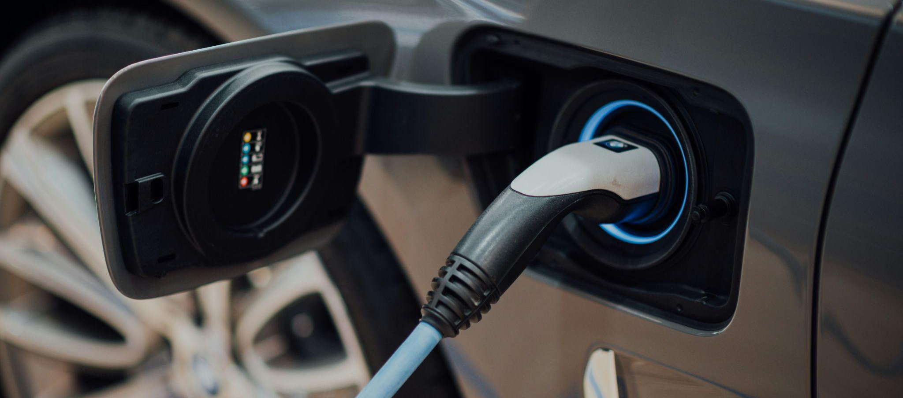
DA 353 - Dr.Bonifonte
introduction
data exploration
model formulation
result
sensitivity analysis
conclusion
thank you for listening!

